Slide 1
SPM G5T7
PM REVIEW
Beh Wei Chen
Wong Wei Ling
Goh Soo Chi
Lim Jia Yu
Shermin Tan

Slide 2
TABLE OF CONTENTS
01
04
Functionalities
Bug Metrics
02
05
Milestones
Roles & Responsibilities
03
06
Schedule
Pair Programming Teams & Rotation Plan

Slide 3
FUNCTIONALITIES
No functionalities to be dropped/added at the moment
No PHP frameworks used
Managed to finish login + 1 functionality (Bootstrap)
IP address: 18.191.224.119
Admin password for cloud deployment: G5T7adm#

Slide 4
Milestones
Iteration No. | Milestone | Date | PM In Charge
1 | PM Review | 3 Oct | Jia Yu
2 | Application Demo and Progress Update | 17 Oct | Wei Chen
3 | User Acceptance Test | 31 Oct | Shermin
4 | Final Submission | 17 Nov | Wei Ling
5 | Final Presentation | 21 Nov | Geralyn

Slide 5
SCHEDULE BREAKDOWN FOR ITERATION 1 (2019/09/16 - 2019/10/03)
Task_ID | Task | Planned Start | Planned Finish | Buffer | Pair
1 | Plan project | 2019/09/16 | 2019/09/16 | - | -
2 | Create SQL scripts and DAOs | 2019/09/16 | 2019/09/16 | - | 1
3 | Create login.php and style.css | 2019/09/17 | 2019/09/17 | - | 2
4 | Complete DAOs and classes | 2019/09/19 | 2019/09/19 | 1 | 2
5 | Create Student & Admin index.php | 2019/09/21 | 2019/09/21 | 1 | 1
6_1 | Bootstrap student & course csv validation | 2019/09/22 | 2019/09/22 | - | 2

Slide 6
SCHEDULE BREAKDOWN FOR ITERATION 1 (2019/09/16 - 2019/10/03)
Task_ID | Task | Planned Start | Planned Finish | Buffer | Pair
6_2 | Bootstrap section & prerequisite csv validation | 2019/09/23 | 2019/09/23 | - | 1
6_3 | Bootstrap course_completed & bid csv validation | 2019/09/24 | 2019/09/24 | - | 2
7 | Combine bootstrap function | 2019/09/25 | 2019/09/25 | - | 1
8 | Amend protect.php to separate student and admin logins | 2019/09/28 | 2019/09/28 | 2 | 1
9 | Authenticate and bootstrap json checker | 2019/09/29 | 2019/09/29 | - | 2

Slide 7
SCHEDULE BREAKDOWN FOR ITERATION 1 (2019/09/16 - 2019/10/03)
Task_ID | Task | Planned Start | Planned Finish | Buffer | Pair
10 | Prepare test cases and run it for login and bootstrap | 2019/09/30 | 2019/09/30 | - | 1
11 | Finish up bootstrap testcases and prepare bug metrics | 2019/10/1 | 2019/10/1 | - | 1
12 | Deploy app | 2019/10/1 | 2019/10/1 | - | 2
13 | Prepare PM Review deliverables | 2019/10/2 | 2019/10/2 | - | -

Slide 8
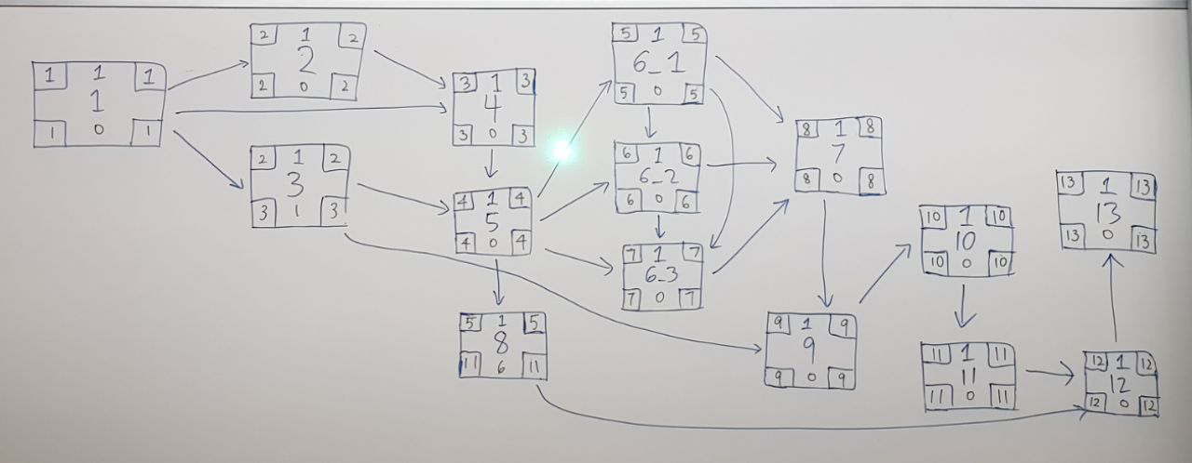
Iteration 1 Workings
Notes:
Include functionalities -> below each box

Slide 9
Iteration 1 Critical Path
6_1
1
2
4
5
6_2
7
9
6_3
10
13
11
12
Notes:
Include functionalities -> below each box

Slide 10
SCHEDULE BREAKDOWN FOR ITERATION 2 (2019/10/04 - 2019/10/17)
Task_ID | Task | Planned Start | Planned Finish | Buffer | Pair
1_1 | Place bid function (active bidding round, invalid inputs, bidding round number, timetable clash) | 2019/10/04 | 2019/10/04 | - | 3
1_2 | Place bid function (check prerequisite courses, sufficient e$, bids for same course) | 2019/10/05 | 2019/10/05 | - | 2
2 | Combine place bid function | 2019/10/07 | 2019/10/07 | - | 1
3 | Drop bid function | 2019/10/08 | 2019/10/08 | - | 3
4 | Drop section function | 2019/10/09 | 2019/10/09 | - | 2

Slide 11
SCHEDULE BREAKDOWN FOR ITERATION 2 (2019/10/04 - 2019/10/17)
Task_ID | Task | Planned Start | Planned Finish | Buffer | Pair
5 | Bid section, drop bid, drop section Json checker | 2019/10/11 | 2019/10/11 | - | 1
6 | Prepare test cases and run it for the 3 student functions | 2019/10/13 | 2019/10/13 | 1 | 3
7 | Prepare bug metrics | 2019/10/14 | 2019/10/14 | - | 2
8 | Deploy app | 2019/10/15 | 2019/10/15 | - | -
9 | Prepare App Demo deliverables | 2019/10/16 | 2019/10/16 | - | -

Slide 12
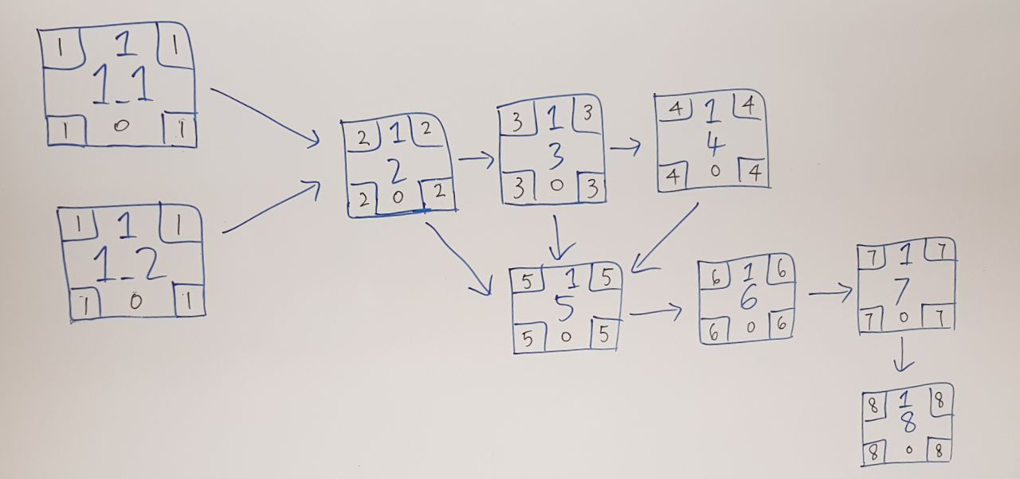
Iteration 2 Workings

Slide 13
Iteration 2 Critical Path
1_1
2
3
4
1_2
5
6
7
8

Slide 14
SCHEDULE BREAKDOWN FOR ITERATION 3 (2019/10/18 - 2019/10/31)
Task_ID | Task | Planned Start | Planned Finish | Buffer | Pair
1 | Start round function (check bidding round and active bidding round) | 2019/10/18 | 2019/10/18 | - | 2
2_1 | Clear round function (round 1) | 2019/10/19 | 2019/10/19 | - | 1
2_2 | Clear round function (round 2) | 2019/10/20 | 2019/10/20 | - | 2
3 | Combine clear round function | 2019/10/21 | 2019/10/21 | - | 1
4 | View bidding function | 2019/10/22 | 2019/10/22 | - | 2
5 | Debugging session | 2019/10/23 | 2019/10/23 | - | 1

Slide 15
SCHEDULE BREAKDOWN FOR ITERATION 3 (2019/10/18 - 2019/10/31)
Task_ID | Task | Planned Start | Planned Finish | Buffer | Pair
6 | Start round, clear round Json checker | 2019/10/24 | 2019/10/24 | - | 2
7 | Prepare test cases and run it for start & clear round | 2019/10/26 | 2019/10/26 | 1 | 1
8 | Prepare bug metrics | 2019/10/27 | 2019/10/27 | - | 2
9 | Deploy app | 2019/10/28 | 2019/10/28 | - | -
10 | Test app on web server | 2019/10/29 | 2019/10/29 | - | -
11 | User Acceptance Test preparations | 2019/10/30 | 2019/10/30 | - | -

Slide 16
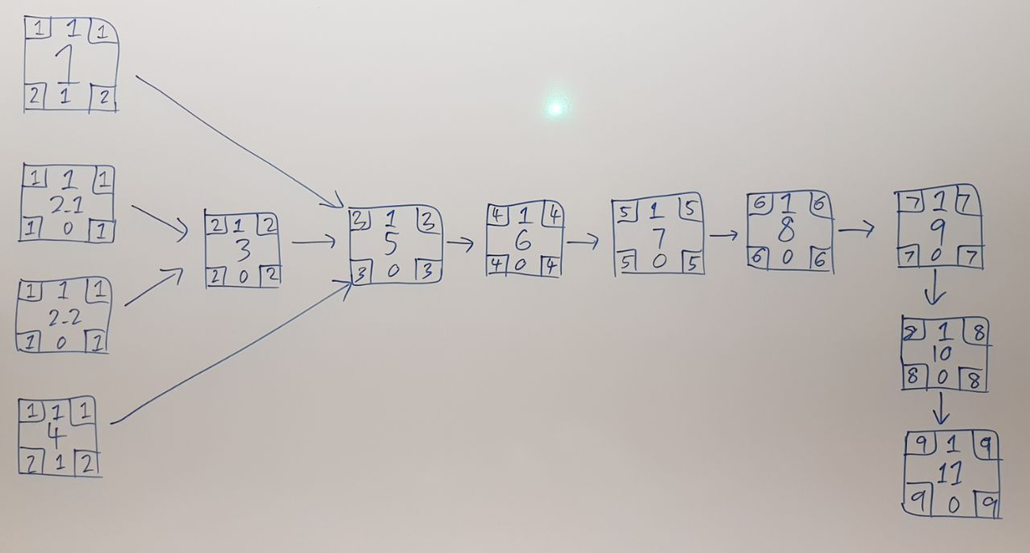
Iteration 3 Workings

Slide 17
Iteration 3 Critical Path
2_1
3
5
6
7
8
9
2_2
10
11

Slide 18
SCHEDULE BREAKDOWN FOR ITERATION 4 (2019/11/01 - 2019/11/17)
Task_ID | Task | Planned Start | Planned Finish | Buffer | Pair
1 | Prepare additional test cases | 2019/11/01 | 2019/11/02 | - | 1
2 | Fix all bugs from UAT | 2019/11/03 | 2019/11/07 | - | 2
3 | Prepare bug metrics | 2019/11/08 | 2019/11/10 | - | 1
4 | Deploy app | 2019/11/11 | 2019/11/11 | - | -
5 | Test app on web server | 2019/11/12 | 2019/11/14 | - | -
6 | Final presentation preparations | 2019/11/15 | 2019/11/17 | - | -
Notes:
Missing: Buffer time, critical path

Slide 19
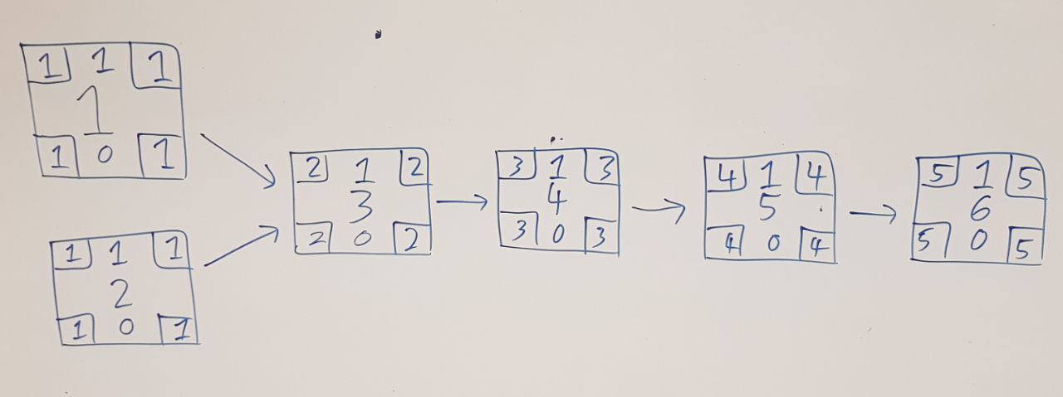
Iteration 4 Workings

Slide 20
Iteration 4 Critical Path
1
3
4
5
6
2

Slide 21
How We Came Up with Our Schedule
Work should be allocated fairly across the team for every iteration
Tasks scheduled should have been broken down such that they are achievable within the span of the pair programming session (estimated to the best of our abilities)
To minimise github conflicts, pairs should ideally try to coordinate and work on different days or at different timings

Slide 22
Bug Metrics
 | Iteration | Function | Description | Severity | Score
1 | 1 | Bootstrap | Start round and clear round link placeholders missing from bootstrap page | Low | 1
2 | 1 | Bootstrap | Failed to print correct number of bid.csv rows processed | High | 5
3 | 1 | Bootstrap | Course.php convertDateTime function var_dumps a bunch of datetime objects on json | Low | 1
Notes:
What is the current value for the metric & did you have to take any action according to your mitigation plan?

Slide 23
Roles and Responsibilities
 | PM | Pair (1) | Pair (2) | Pair (3) | Dates | Milestones
Iteration 1 | Jia Yu | Wei Chen, Shermin | Geralyn, Wei Ling | - | 2019/09/16 - 2019/10/3 | PM Review
Iteration 2 | Wei Chen | Jia Yu, Shermin | Geralyn, Wei Ling | Wei Chen Geralyn | 2019/10/04 - 2019/10/17 | App Demo
Iteration 3 | Shermin | Wei Chen, Wei Ling | Geralyn, Jia Yu | - | 2019/10/18 - 2019/10/31 | UAT
Iteration 4 | Wei Ling | Wei Chen, Shermin | Geralyn, Jia Yu | - | 2019/11/01 - 2019/11/17 | Final Submission
Iteration 5 | Geralyn | Wei Chen, Wei Ling Jia Yu, Shermin |  |  | 2019/11/18 - 2019/11/21 | Final Presentation

Slide 24
Pair Programming Teams & Rotation Plan
 | Pair (1a) | Pair (1b) | Pair (2a) | Pair (2b) | PM
Iteration 1 | Wei Chen | Shermin | Geralyn | Wei Ling | Jia Yu
Iteration 2 | Jia Yu | Shermin | Geralyn | Wei Ling | Wei Chen
Iteration 3 | Wei Chen | Wei Ling | Geralyn | Jia Yu | Shermin
Iteration 4 | Shermin | Wei Chen | Geralyn | Jia Yu | Wei Ling
Iteration 5 | Wei Ling Wei Chen Shermin Jia Yu |  |  |  | Geralyn

Slide 25
How We Came Up with Our Rotation Plan
Everyone must be PM at least once
Programming pairs are formed based on PHP proficiency (Web App Development) and compatibility of schedules
Rotation follows the suggested 2-week iterations, also in accordance to the planned milestones

Slide 26
THANK YOU!

